Slide 1


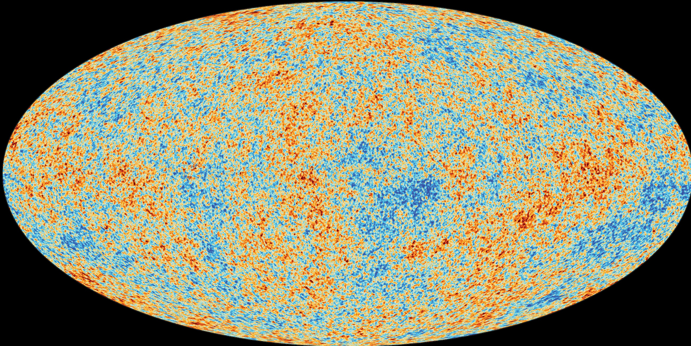
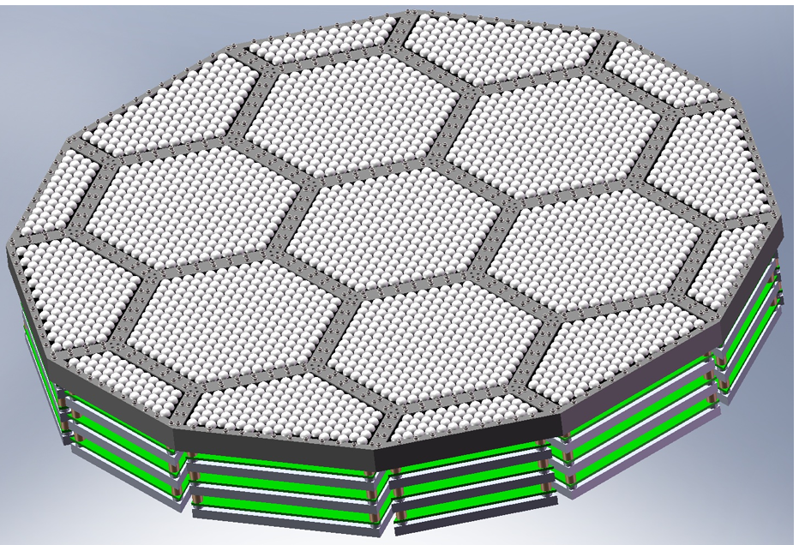
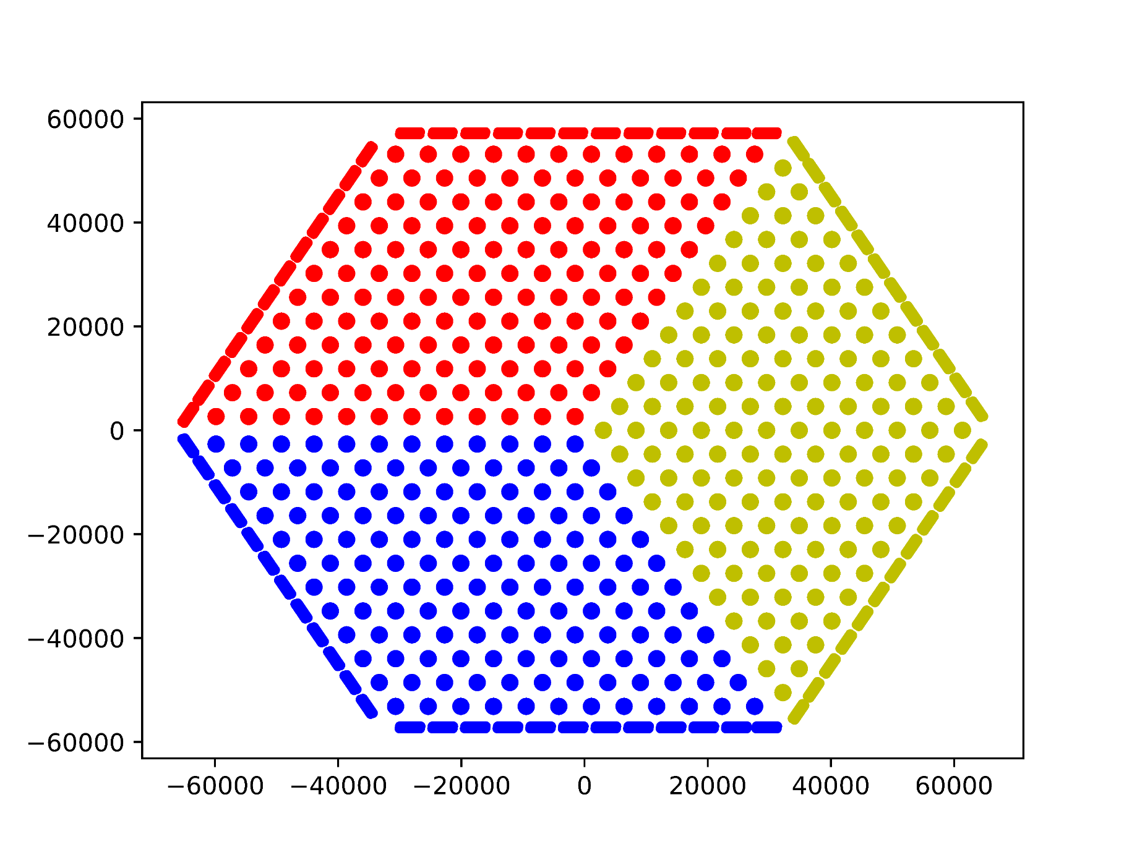
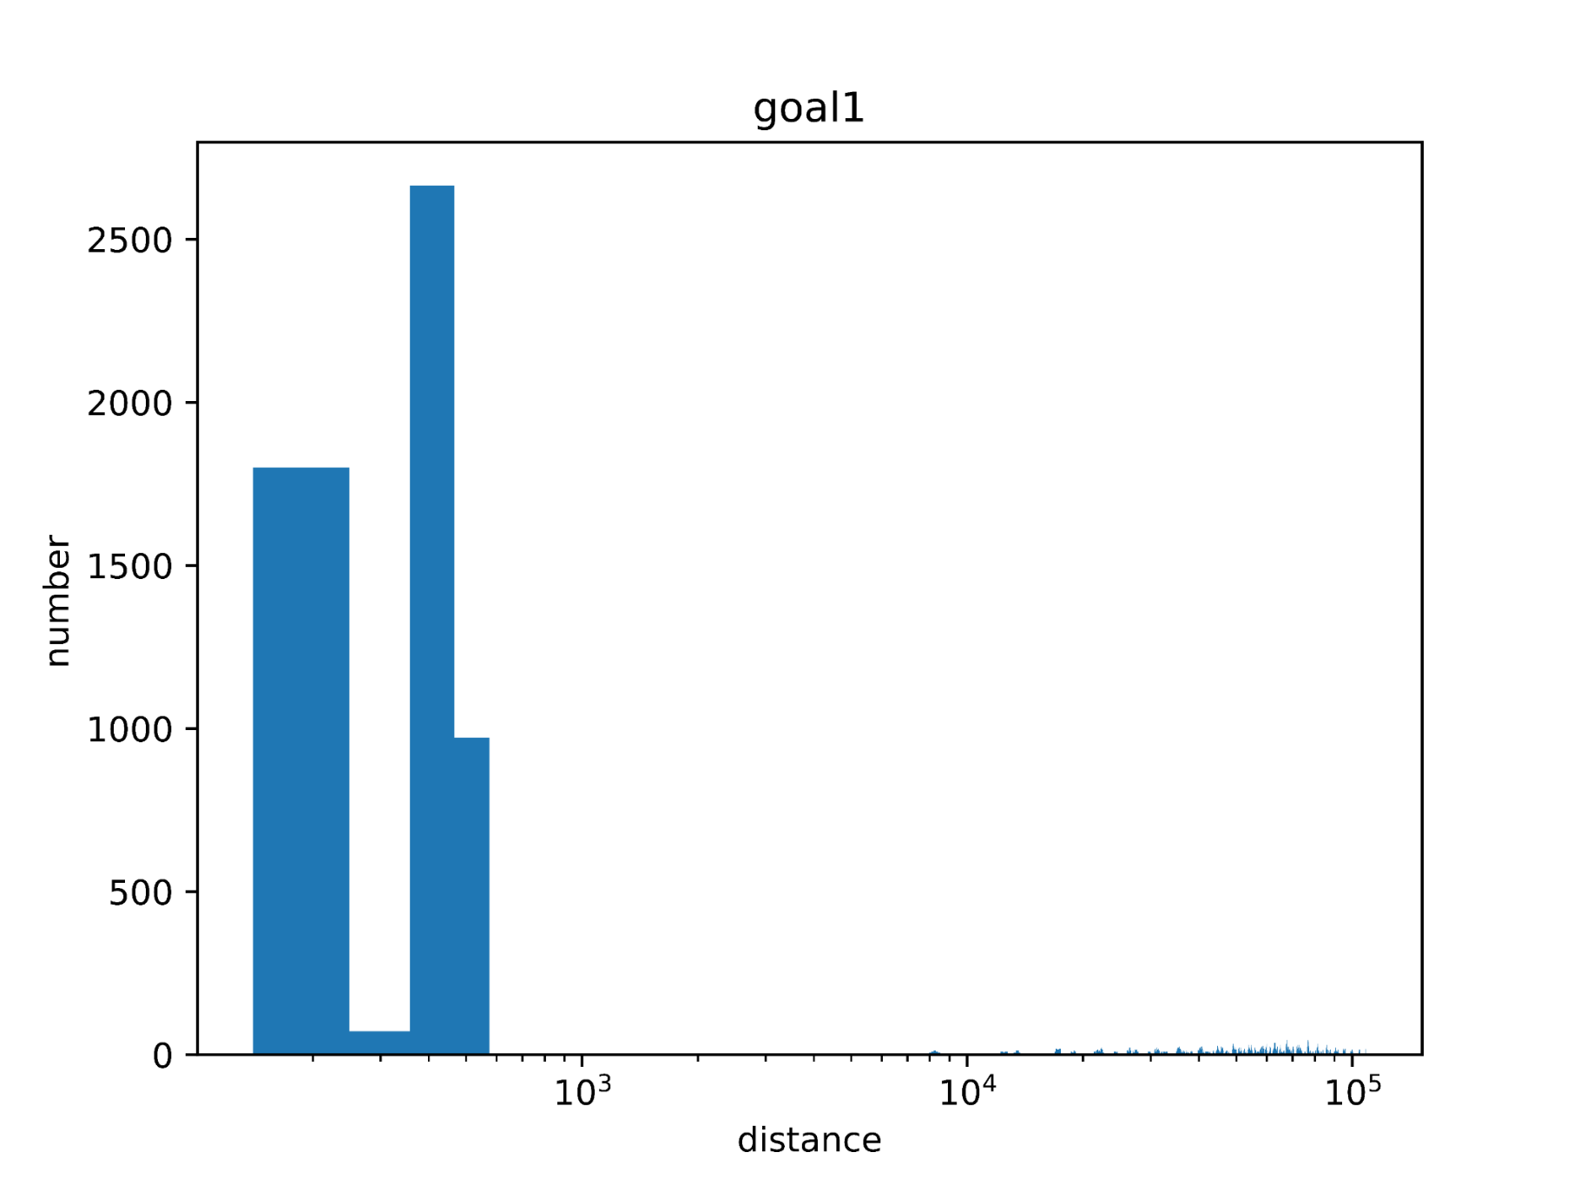
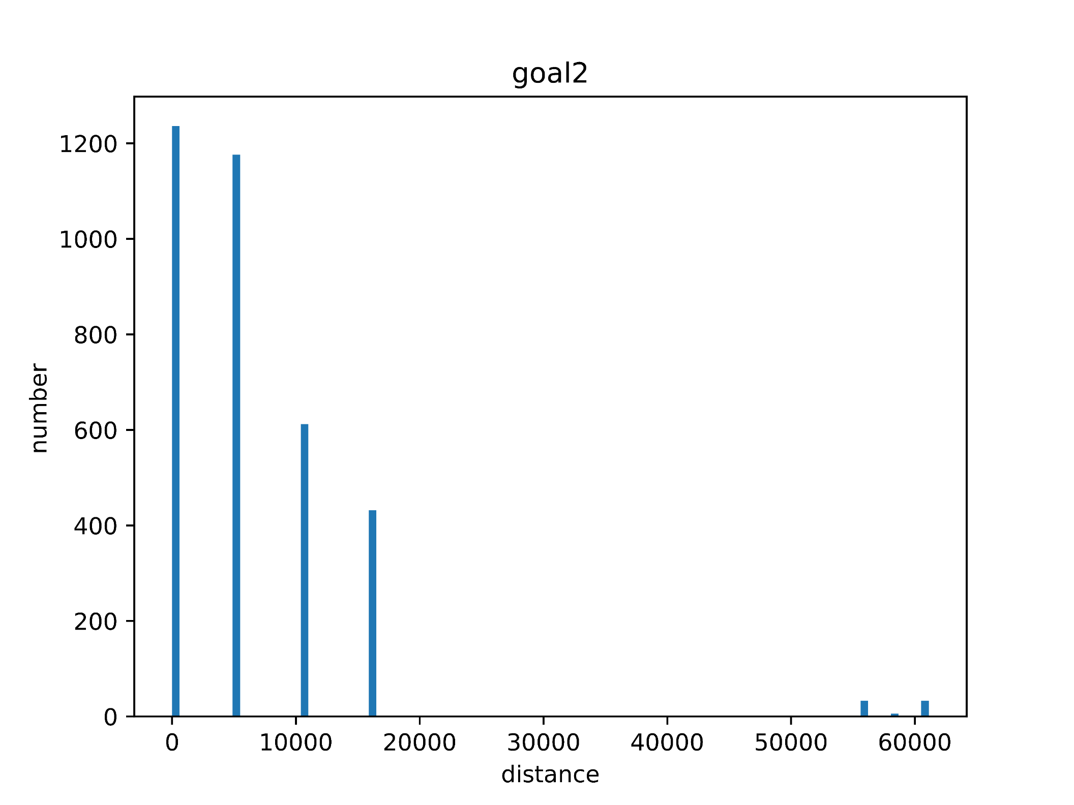
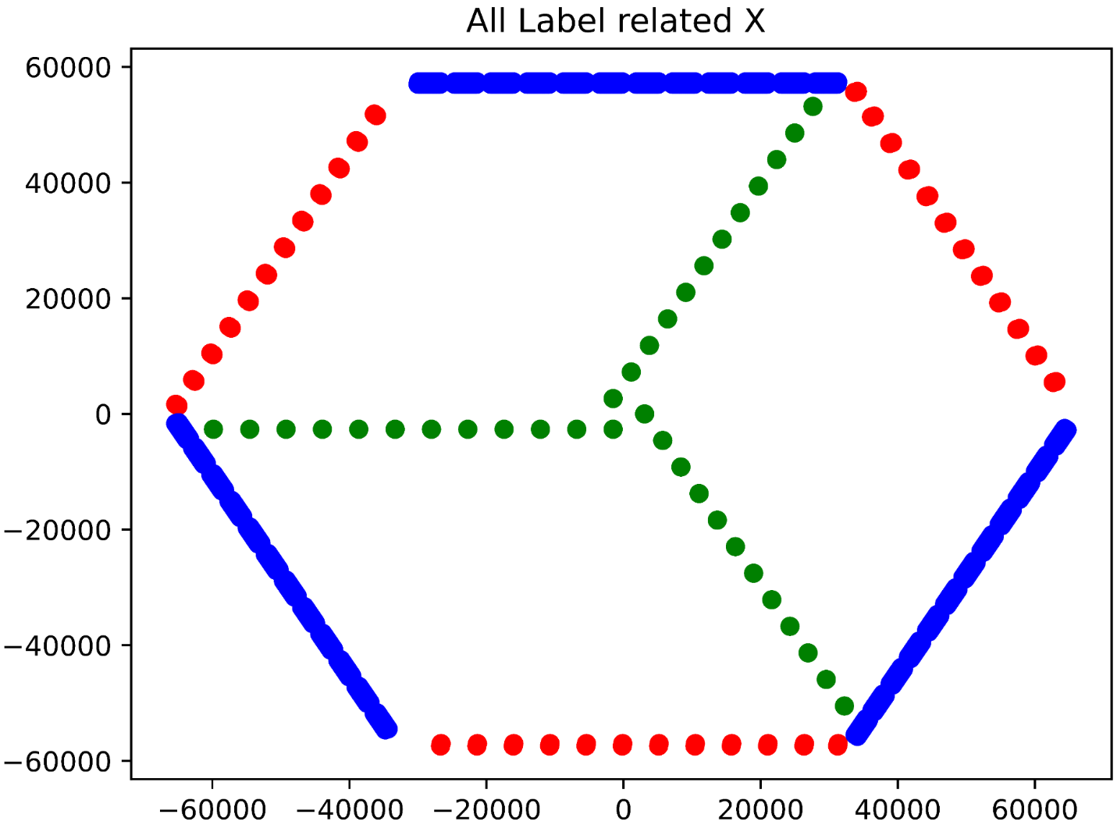
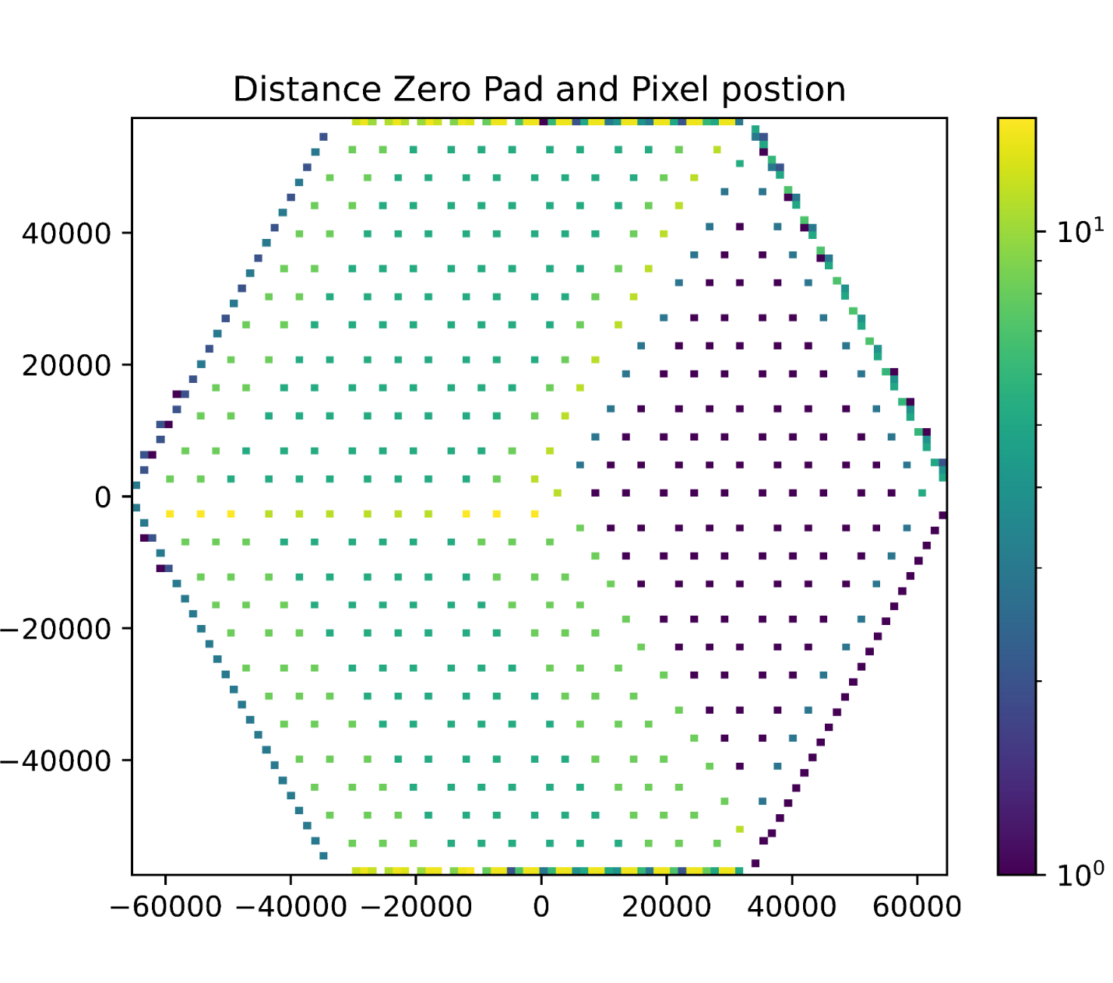
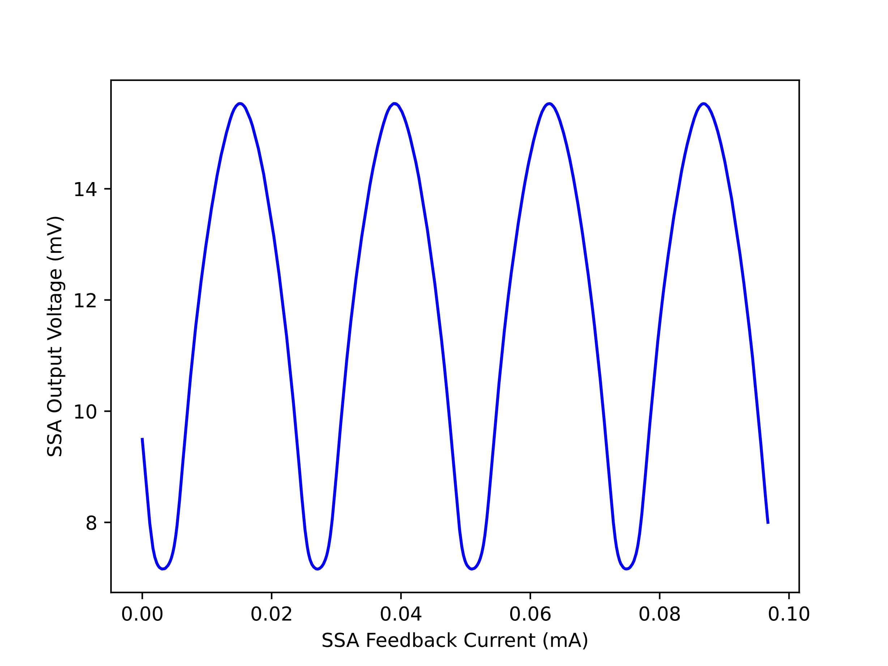
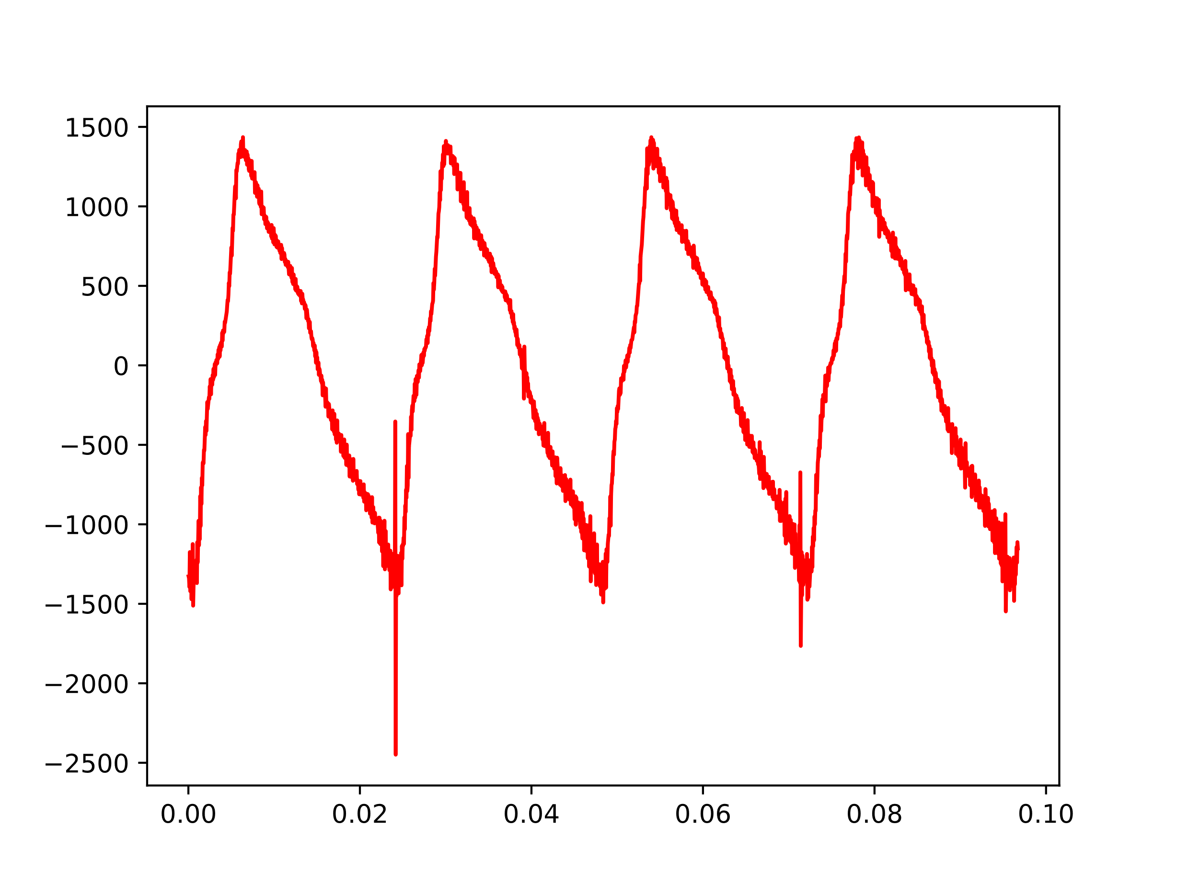
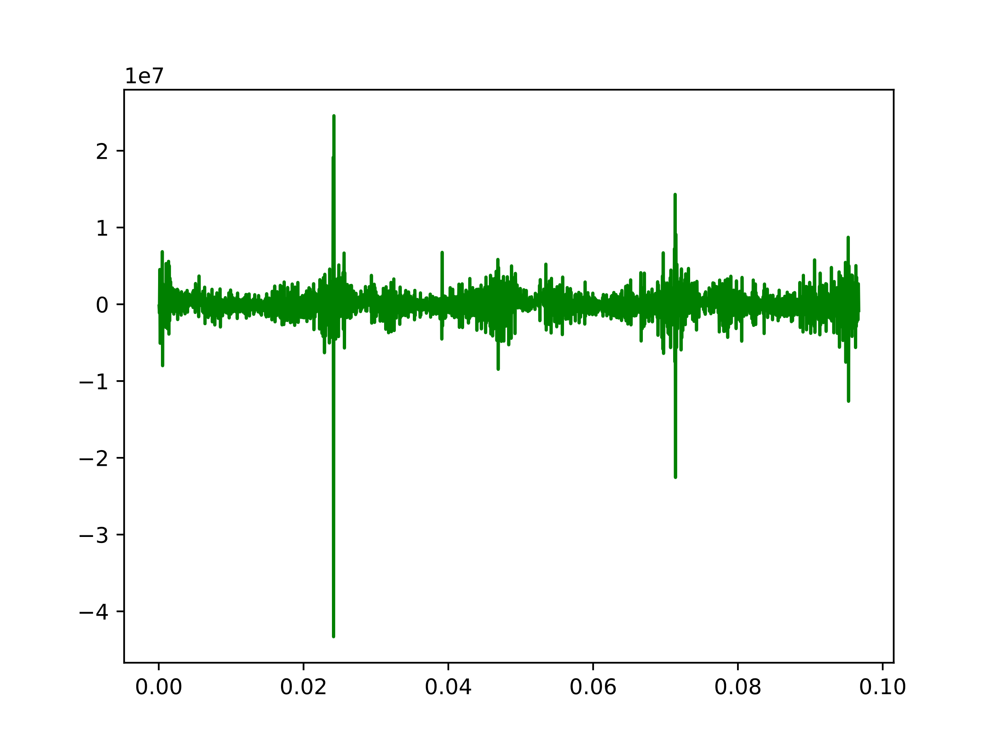
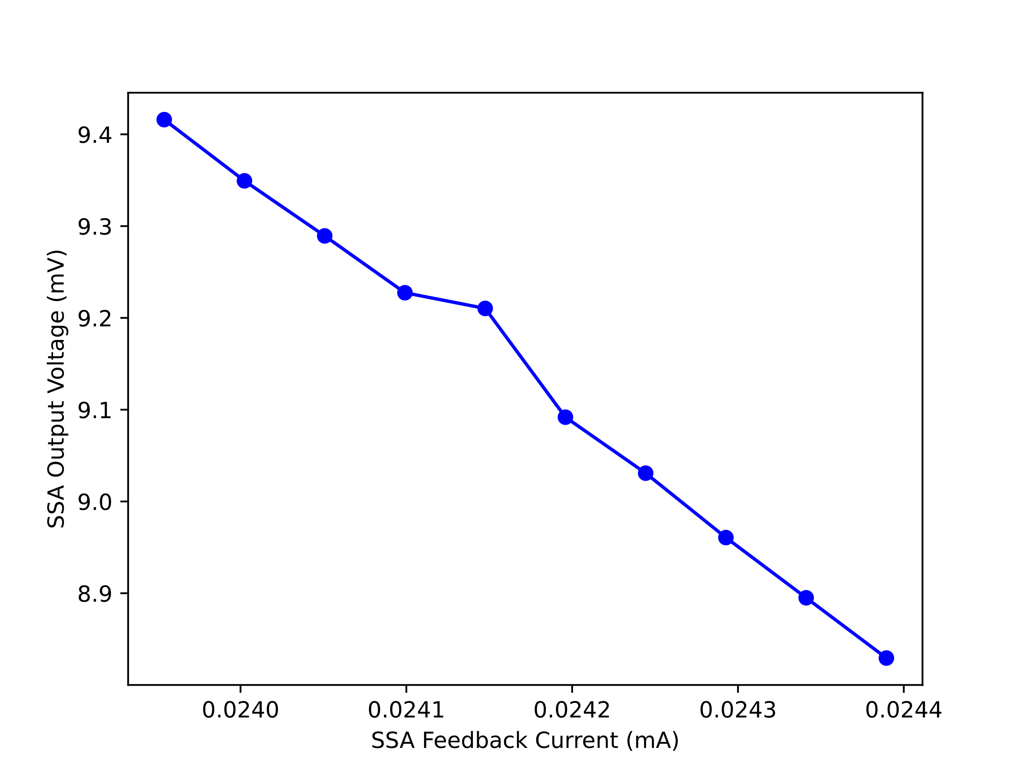
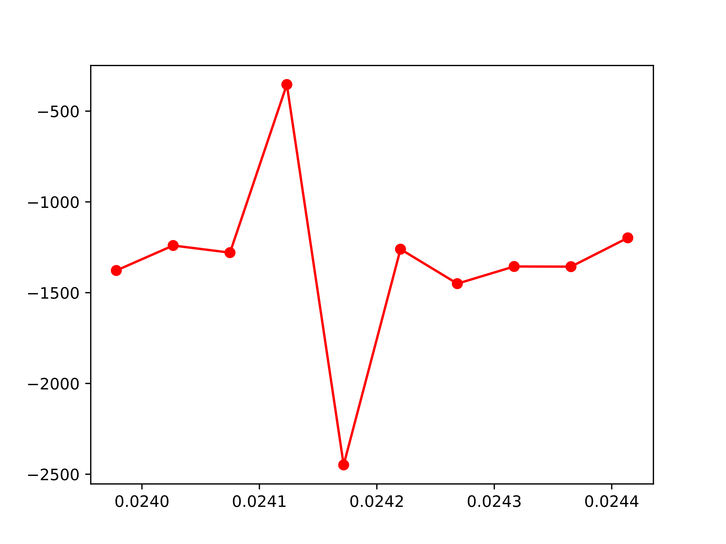
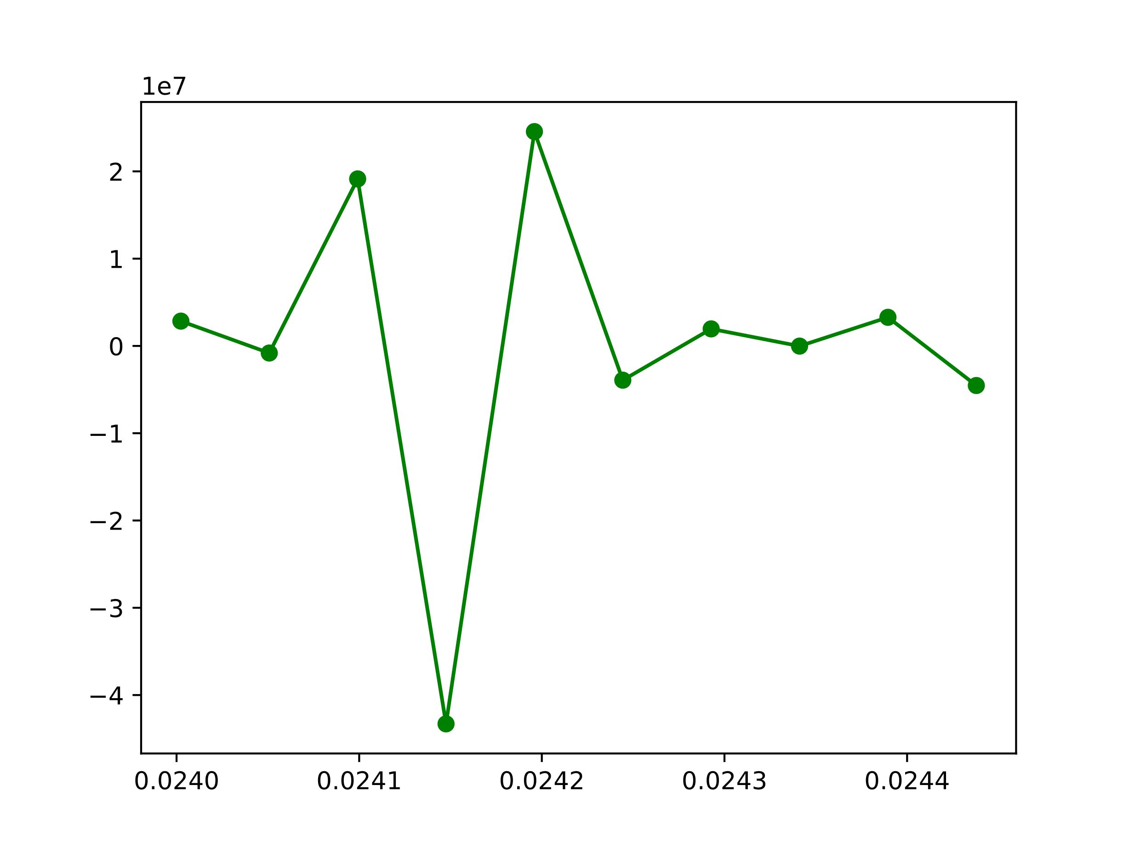
Analysis Wafer and SQUID for better measurement the CMB
Yifu Chen¹, and Dr. Darcy Barron¹
¹Center for High Technology Materials and Department of Physics and Astronomy, University of New Mexico, Albuquerque, NM, USA
Introduction
Wafer mapping
Intro about wafer?
Why important? avoid detector crosstalk
SQUID Tuning
New
FIG
conclusion (future work)
References
Acknowledge
ESA/Planck Collaboration (2018).
B. A. Benson, et al., Proceedings of SPIE (2014).
L.A. Howe, Doctor thesis (2019).
K. Prabhu, ApJ (2024).

Slide 2
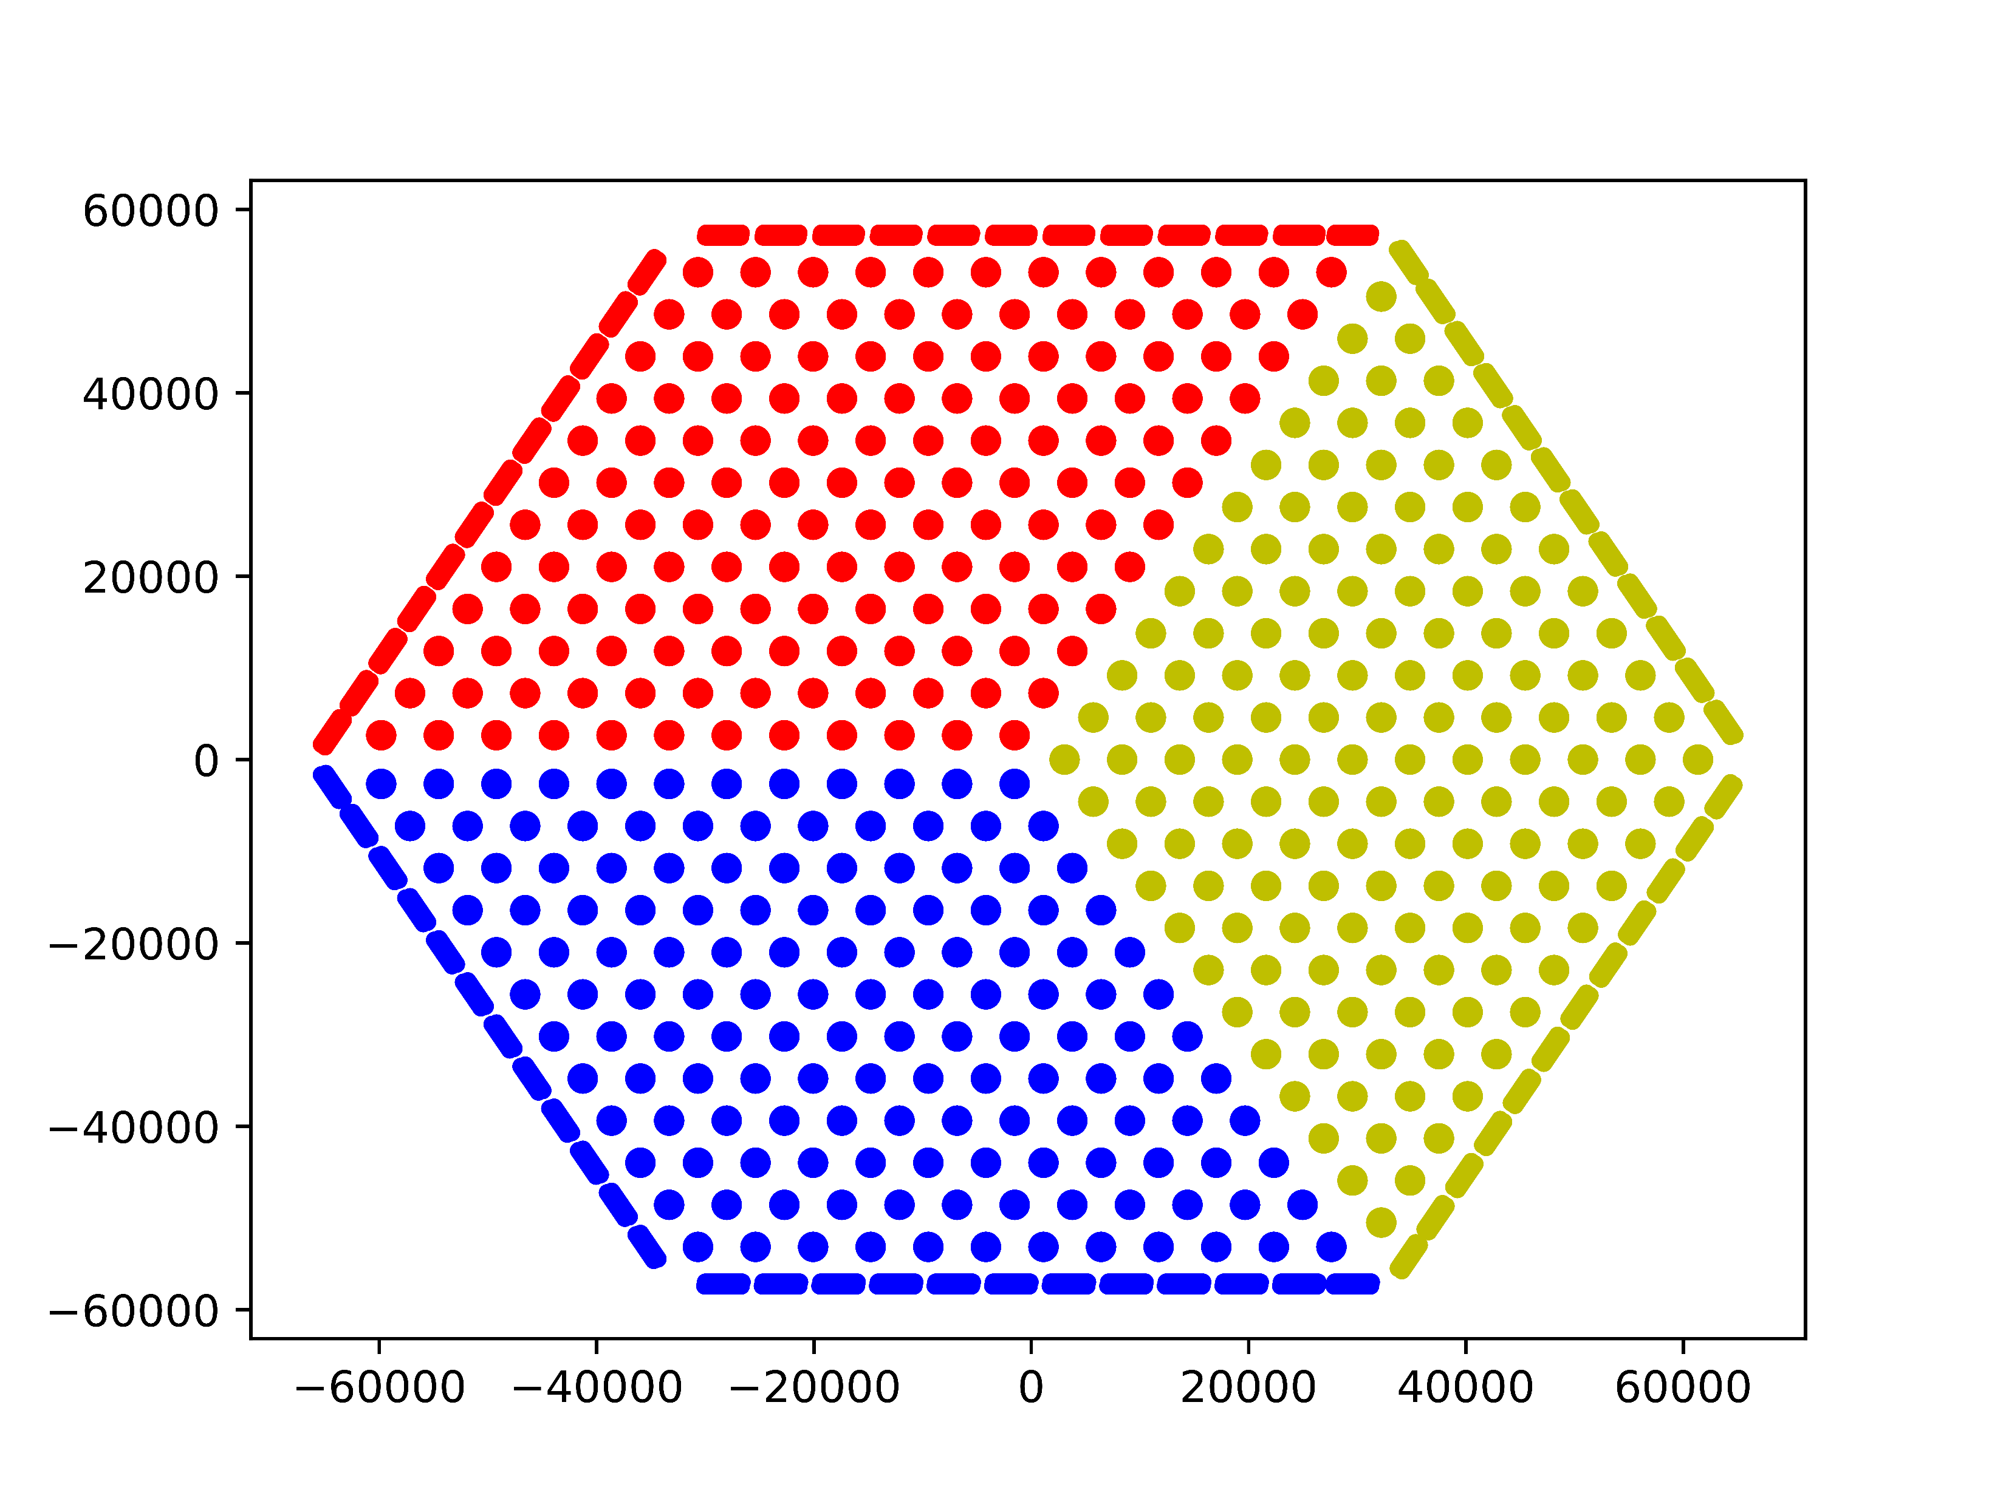

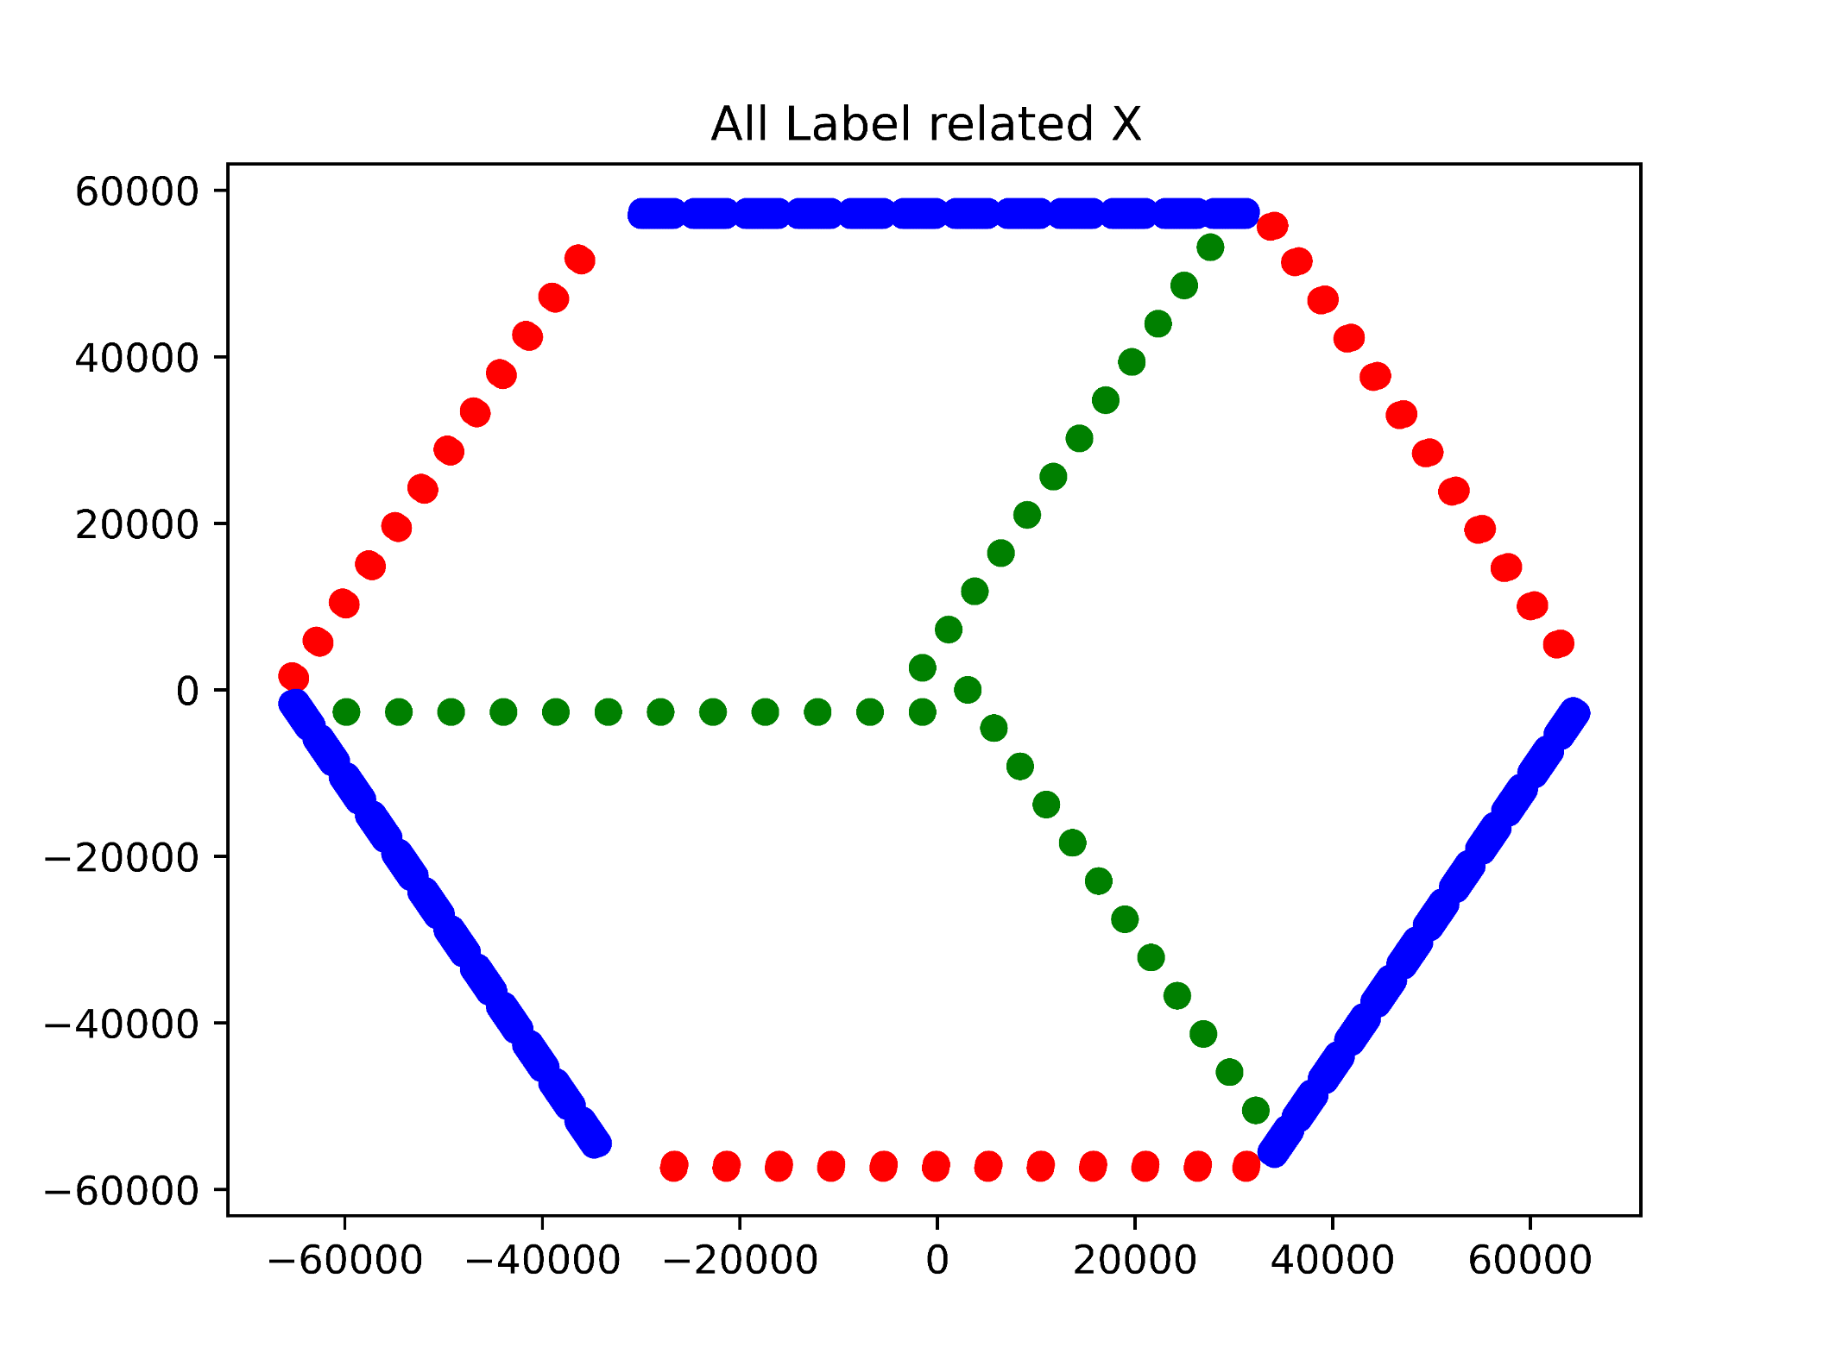
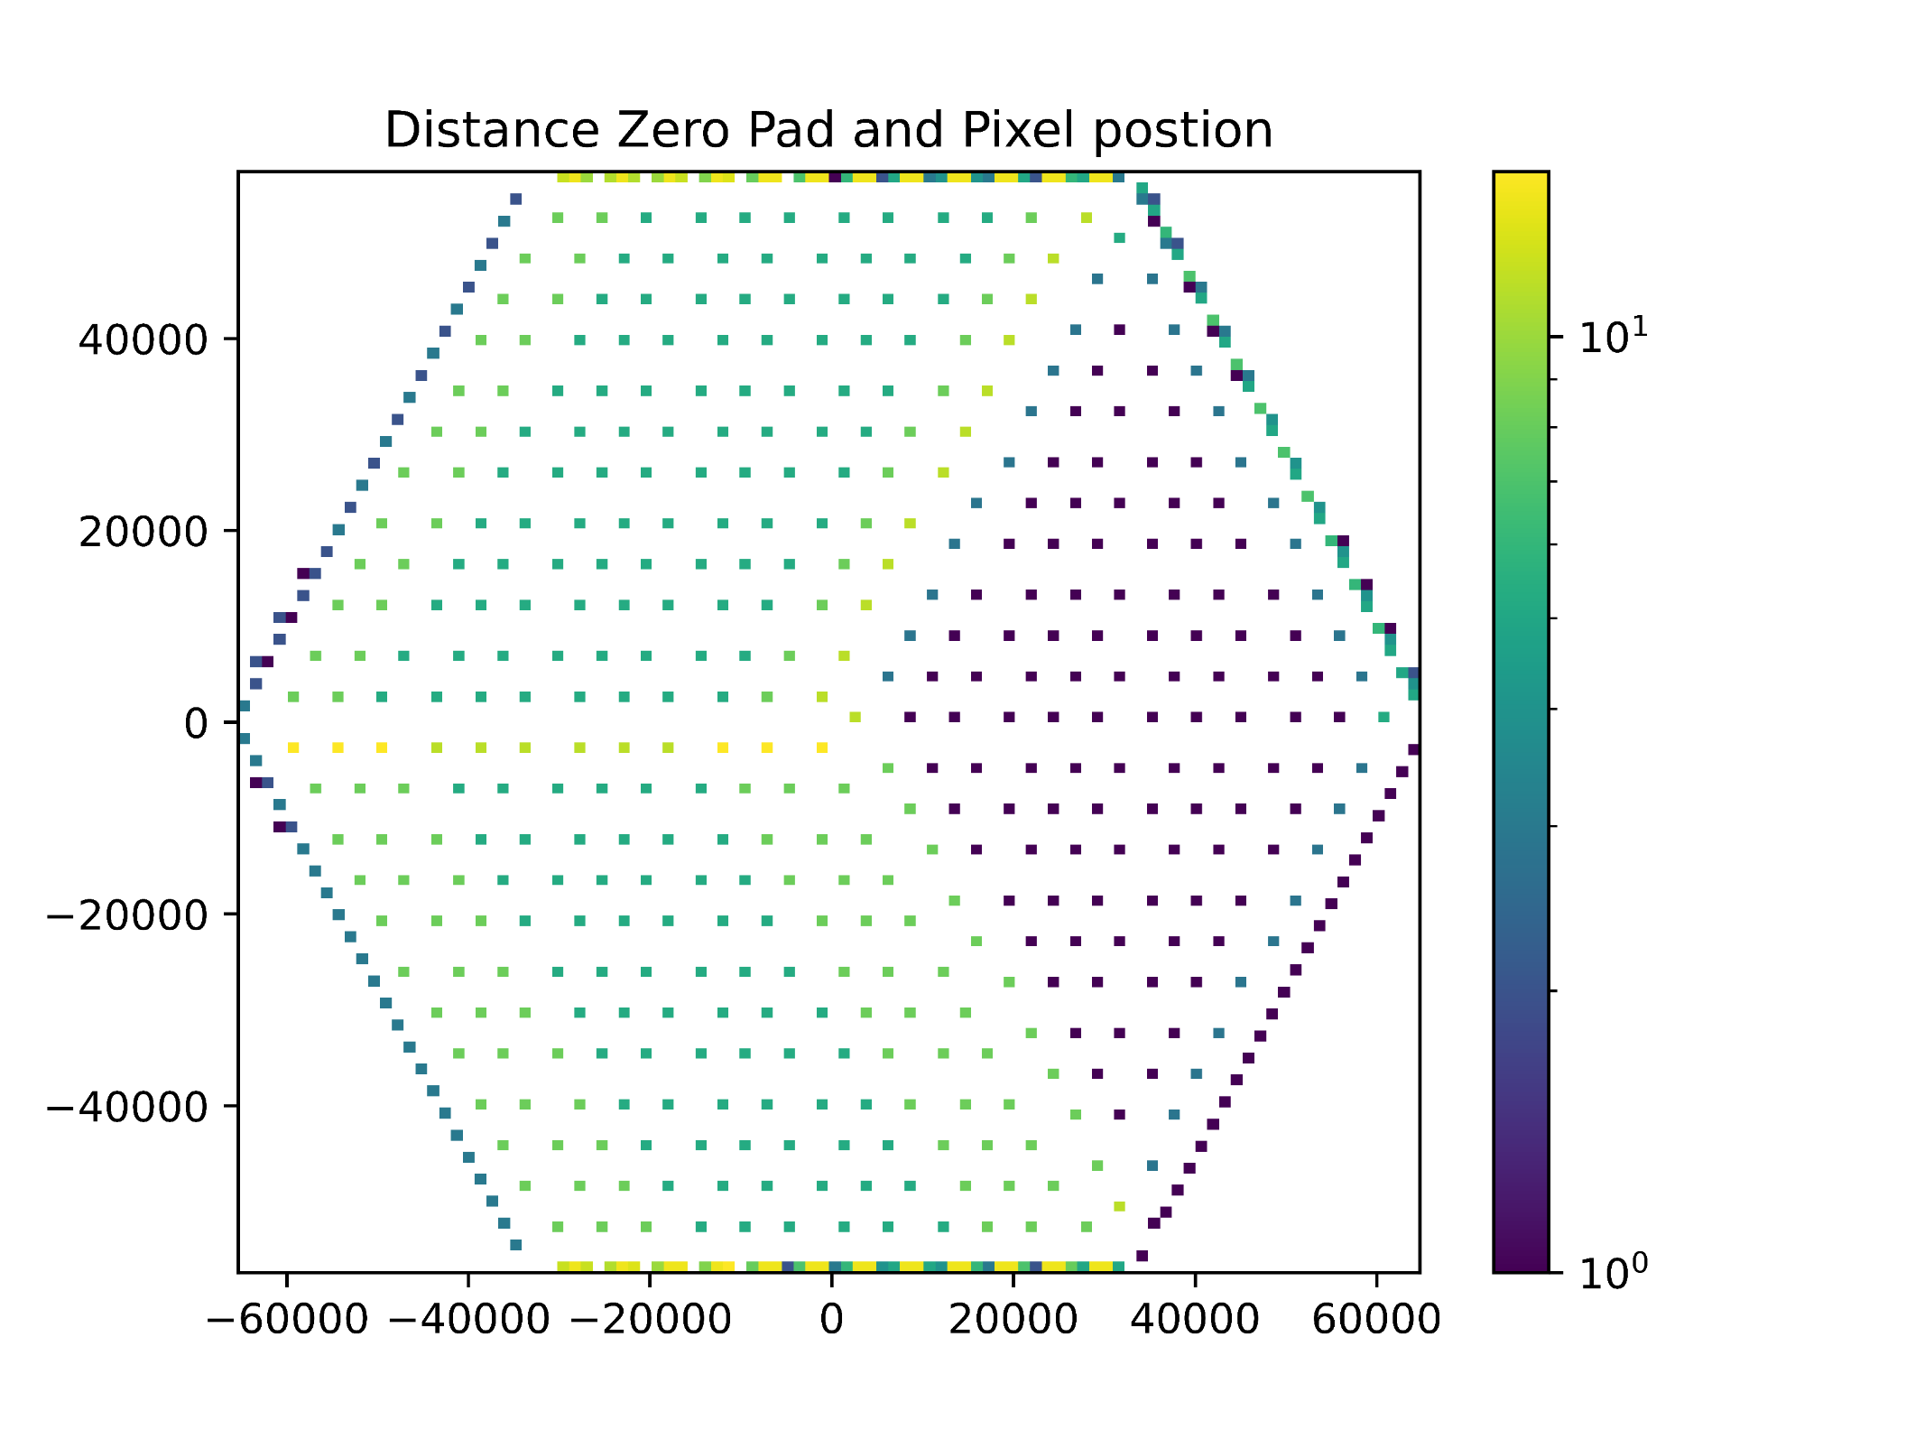
Analysis Wafer and SQUID for better measurement the CMB
Yifu Chen¹, and Dr. Darcy Barron¹
¹Center for High Technology Materials and Department of Physics and Astronomy, University of New Mexico, Albuquerque, NM, USA
Introduction
CMB FIG
SQUID Tuning
Wafer mapping
Intro about wafer?
Why important? avoid detector crosstalk
New FIG
conclusion (future work)
References
Acknowledge
B. A. Benson, et al., Proceedings of SPIE (2014).

